Slide 1









PLANTASY
GARDENS
Presented by The Justice League

Slide 2

JUSTICE LEAGUE MEMBERS
Hayley Booysen
u24868346
Bandile Mnyandu
u24676394
Karabo Nkomo
u24865169
Njabulo Mathonsi
u24676412
Marchant Grootboom
u21549232

Slide 3
FUNCTIONAL REQUIREMENTS
Greenhouse / Plant System | Pattern Used
Allow propagation of plants through cloning. | Prototype
Apply different care strategies for different types of plants (lowCare, mediumCare, highCare). | Strategy
Simulate plant growth stages (Seedling → Growing → Mature → Withered). | State
Build plants dynamically with custom attributes. | Builder
Maintain a centralized inventory of plants and their seeds and keeps track of its states. | Singleton + Observer + State

Slide 4
FUNCTIONAL REQUIREMENTS
Customer and Sales | Pattern Used
Enable communication between customers and staff. | Mediator
Allow customers to customize plants (pot, wrapping). | Decorator
Process purchases and record sales. | Command
Delegate delivery and request handling among staff. | Chain of Responsibility

Slide 5
FUNCTIONAL REQUIREMENTS
Staff and Management | Pattern Used
Notify staff of plant changes (e.g., maturity). | Observer + Mediator
Support various staff roles (customer staff, care staff). | Factory
Enable staff to iterate through plant and seed collections. | Iterator

Slide 6
FUNCTIONAL REQUIREMENTS
System Operations | Pattern Used
Manage zones containing groups of plants. | Composite
Ensure a single instance of plant inventory. | Singleton
Clone existing plants for propagation. | Prototype

Slide 7

1.
How it works:
The Greenhouse Simulation models plant growth and sales — plants move from inventory to zones, receive care from staff, and are later customized and purchased by customers, simulating the full nursery lifecycle.
SIMULATION
2.
Simulation tracks:
Customers Interactions
Plant lifecycle
Staff Movement and Hierarchy
Greenhouse Inventory

Slide 8
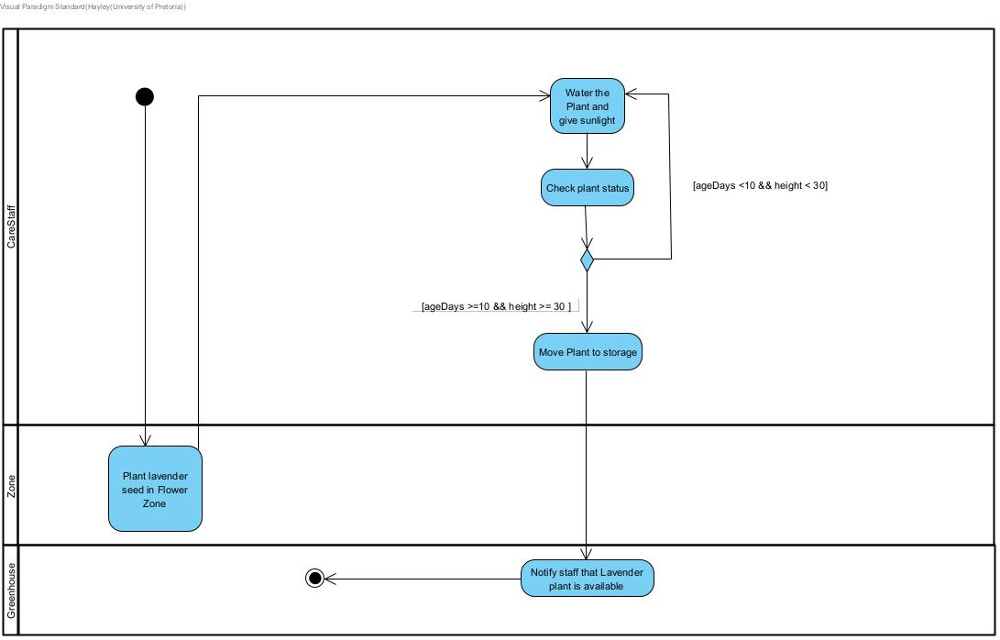
ACTIVITY DIAGRAM

Slide 9
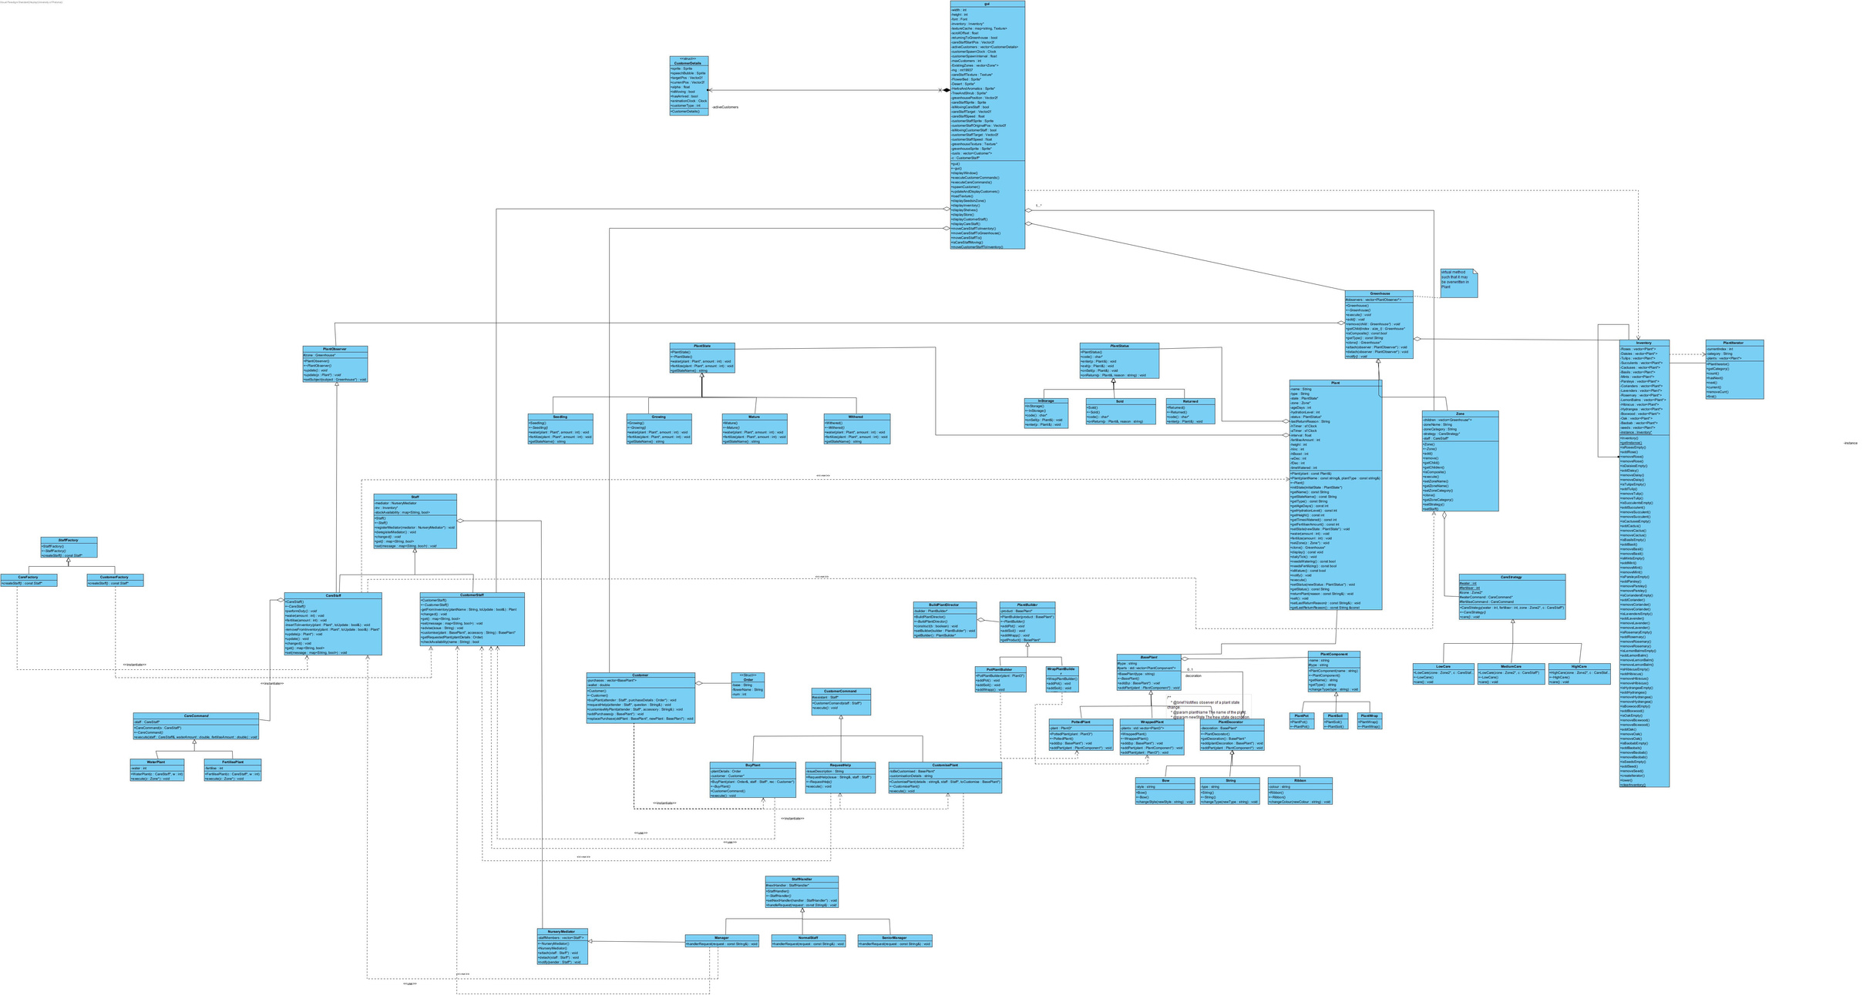
CLASS DIAGRAM

Slide 10
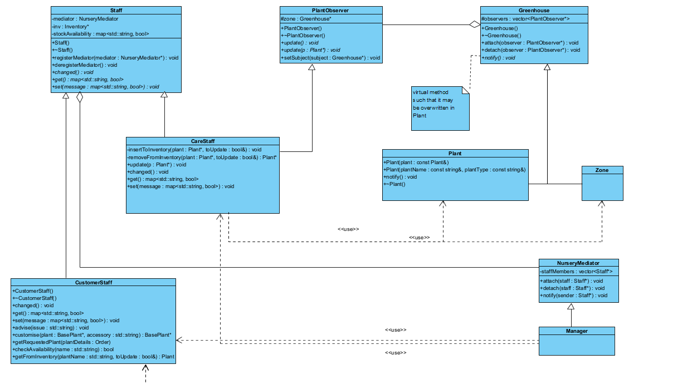
CLASS DIAGRAM:
Pattern 1: Mediator

Slide 11
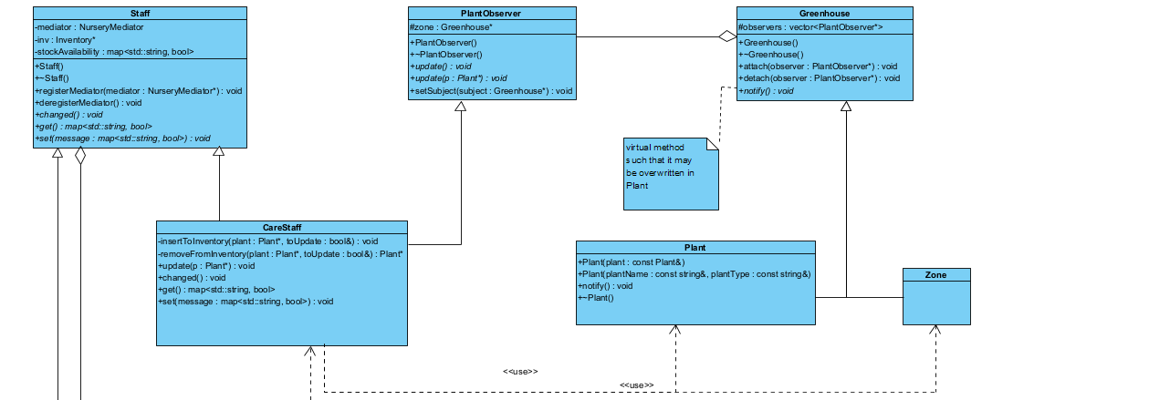
CLASS DIAGRAM:
Pattern 2: Observer

Slide 12
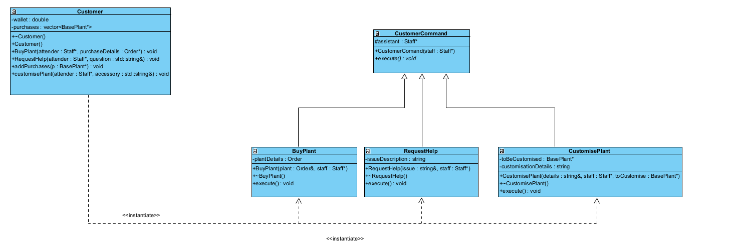
CLASS DIAGRAM:
Pattern 3: Command (1/2)
Customer Command

Slide 13
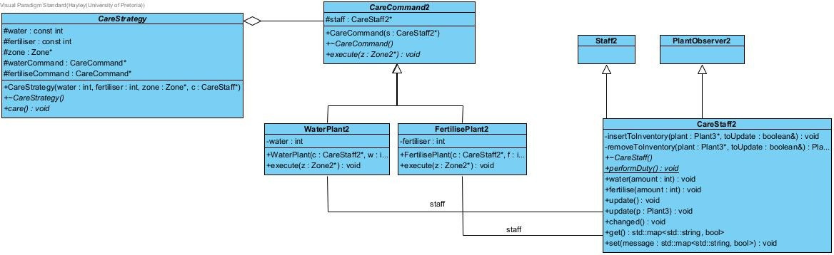
CLASS DIAGRAM:
Pattern 3: Command (2/2)
Care Command

Slide 14
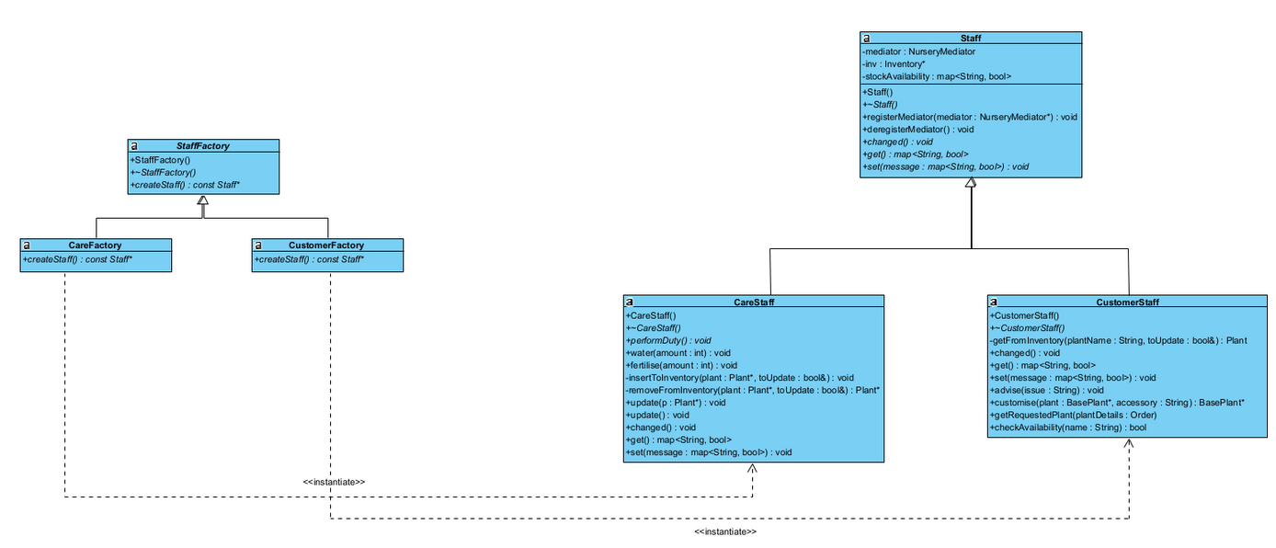
CLASS DIAGRAM:
Pattern 4: Factory

Slide 15
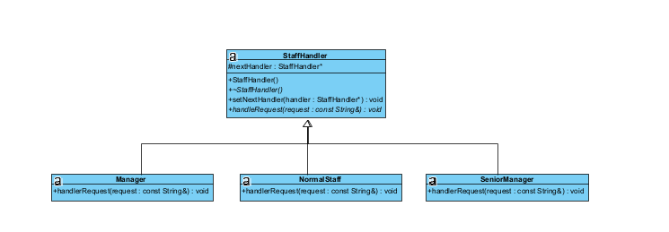
CLASS DIAGRAM:
Pattern 5: Chain of Responsibility

Slide 16
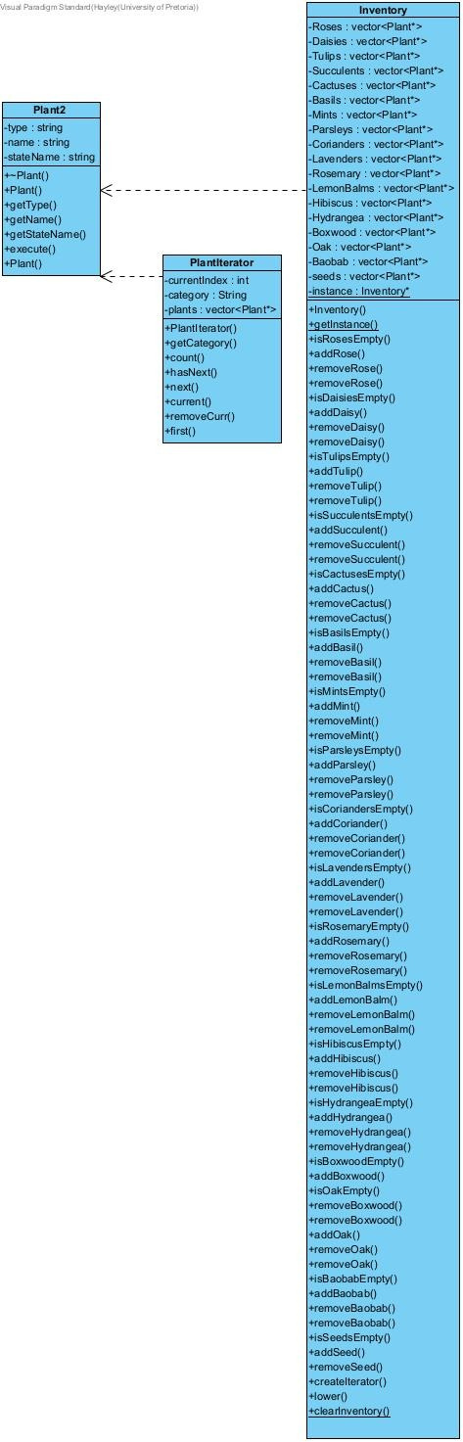
CLASS DIAGRAM:
Pattern 6: Singleton

Slide 17
CLASS DIAGRAM:
Pattern 7: Iterator

Slide 18
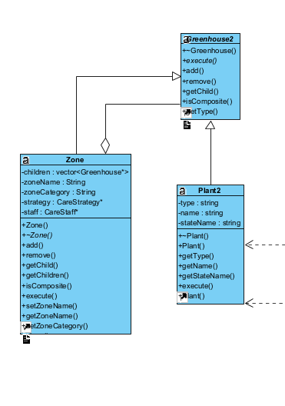
CLASS DIAGRAM:
Pattern 8: Composite

Slide 19
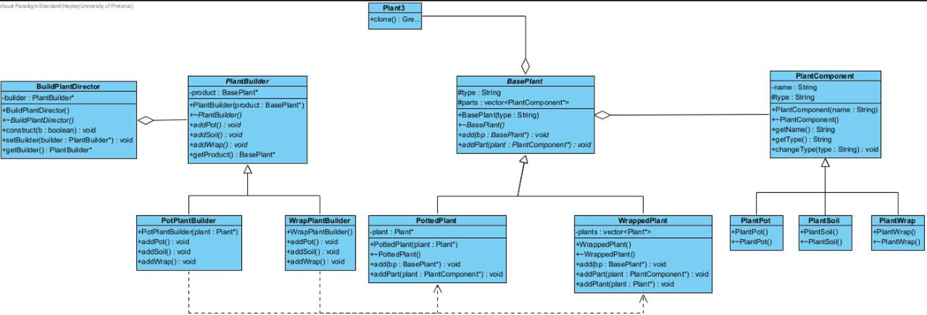
CLASS DIAGRAM:
Pattern 9: Decorator

Slide 20
CLASS DIAGRAM:
Pattern 10: Builder

Slide 21
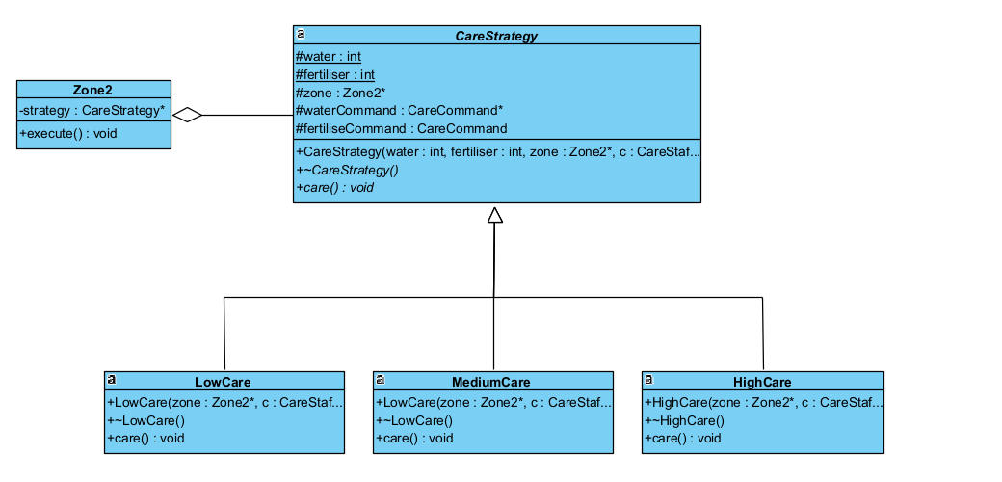
CLASS DIAGRAM:
Pattern 11: Strategy

Slide 22
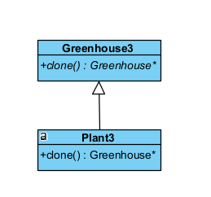
CLASS DIAGRAM:
Pattern 12: Prototype

Slide 23
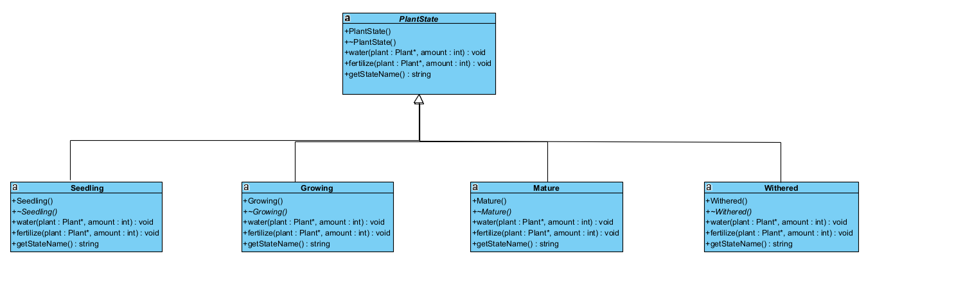
CLASS DIAGRAM:
Pattern 13: State (1/2)
Plant State

Slide 24
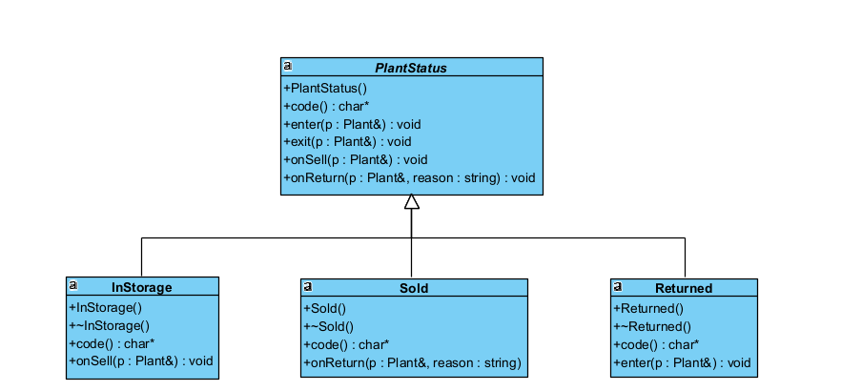
CLASS DIAGRAM:
Pattern 14: State (2/2)
Plant Status

Slide 25


DEMO

Slide 26
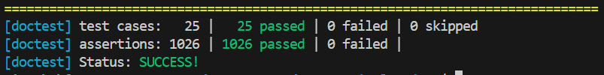
DOCTEST:
UNIT TESTS

Slide 27
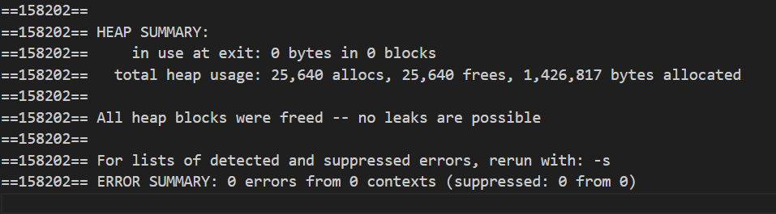
MEMORY SAFETY
UNIT TESTS

Slide 28
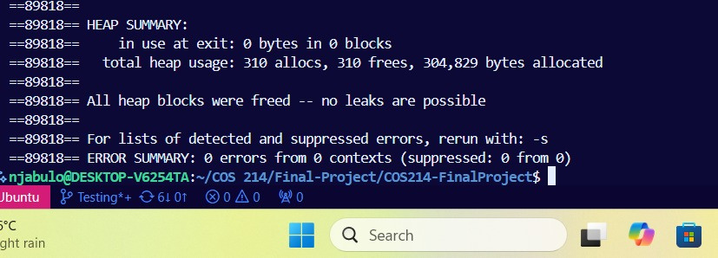
MEMORY SAFETY
DEMO MAIN

Slide 29
SEPERATE BRANCHES FOR SEPERATE DESIGN PATTERNS
THE SHARED PLANT CLASS HAD MULTIPLE VERSIONS AND BECAME CONSOLIDATED IN THE END
AFTER SKELETON IMPELMENTATION AND INDIVIDUAL UNIT TESTS, MERGING WITH TESTING MAIN WAS DONE
GITHUB STRATEGY

Slide 30
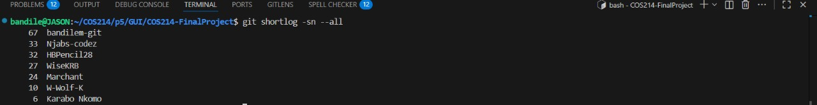
WHEN RUNNING COMMAND GIT SHORTLOG –SN --ALL
NOTE THAT SOME USERNAME APPEAR TWICE
HENCE OUR FINAL TOTALS ARE:
BANDILE MNYANDU: 67
NJABULO MATHONSI: 33
HAYLEY BOOYSEN : 32
KARABO NKOMO : 31
MARCHANT GROOTBOOM : 26
GITHUB COMMITS

Slide 31
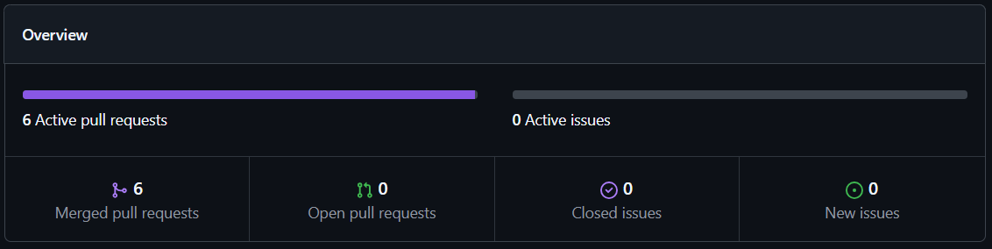
PULL REQUESTS

Slide 32
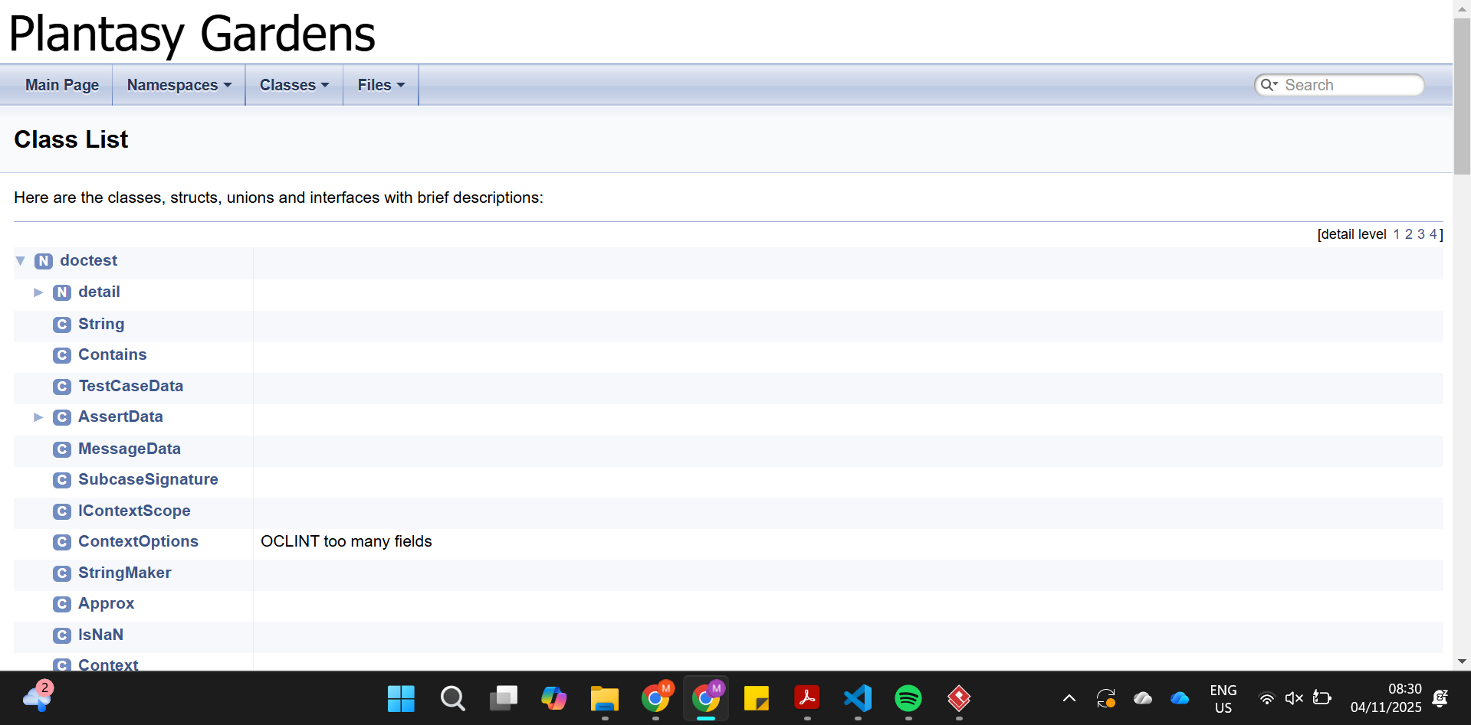
DOXYGEN

Slide 33



QUESTIONS?

